Slide 1
Code Layout in LLVM
By Madison Bradley and Sarah Thomson

Slide 2
A brief refresher…

Slide 3

Our Project
[1]
Nelson’s words: “Gain a holistic understanding of all of the passes in LLVM that change code layout. Is there a better solution?”
[1] https://www.ualberta.ca/en/computing-science/news-and-events/news/2021/march/nelson-amaral-awarded-with-2020-remote-teaching-award.html

Slide 4

So, what does that mean?
“Holistic understanding” = global understanding across the entire pipeline.
Across all IR units (module, function, block, etc.)
Bridge the gap between IR-level transformations and target-specific ones.
Code layout transformations = anything that changes the ordering of the units of code
Transformations changing function and basic block ordering
So, we want to understand how, when, and where units of code move across the ENTIRE pipeline.

Slide 5
Project Structure

Slide 6
Where’d we look?
For IR level
Used PassBuilderPipelines.cpp
Decided to focus on O0/O1/O2/O3 pipelines
No LTO, for now…
Collected all subpipelines, as separated by function
For codegen/MIR level
Used RISCVTargetMachine.cpp and associated passes

Slide 7
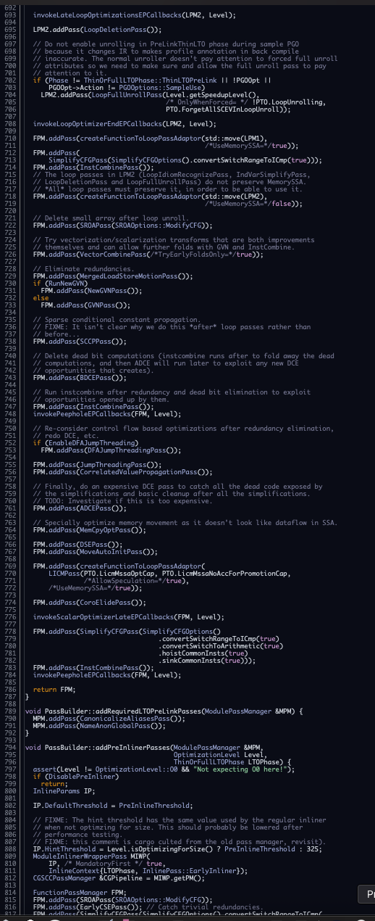
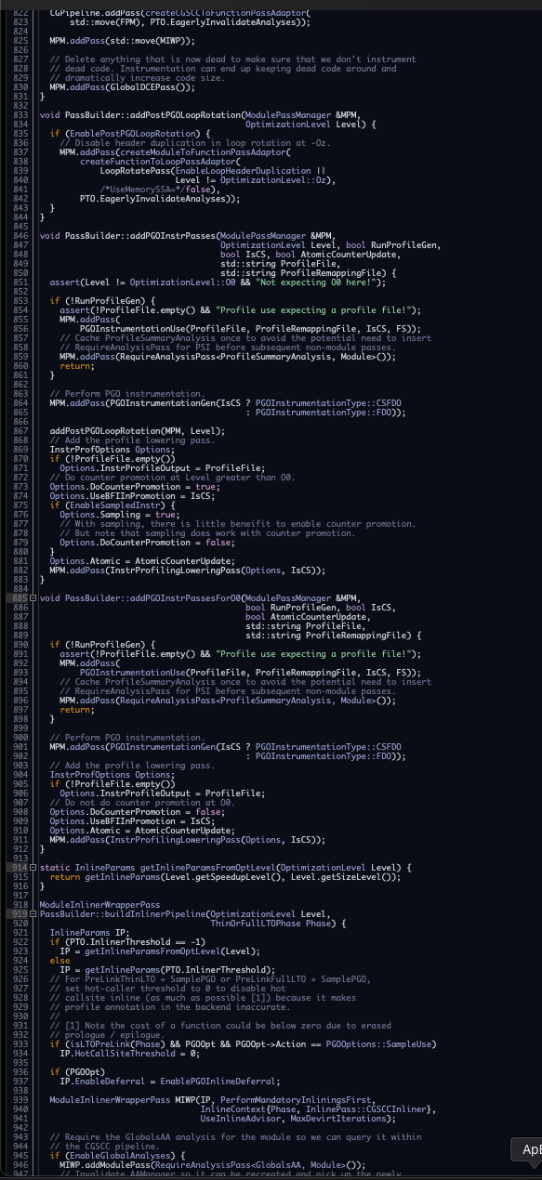
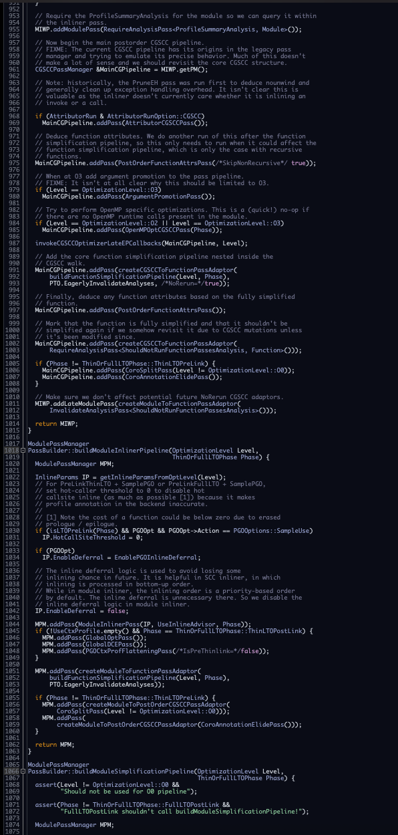
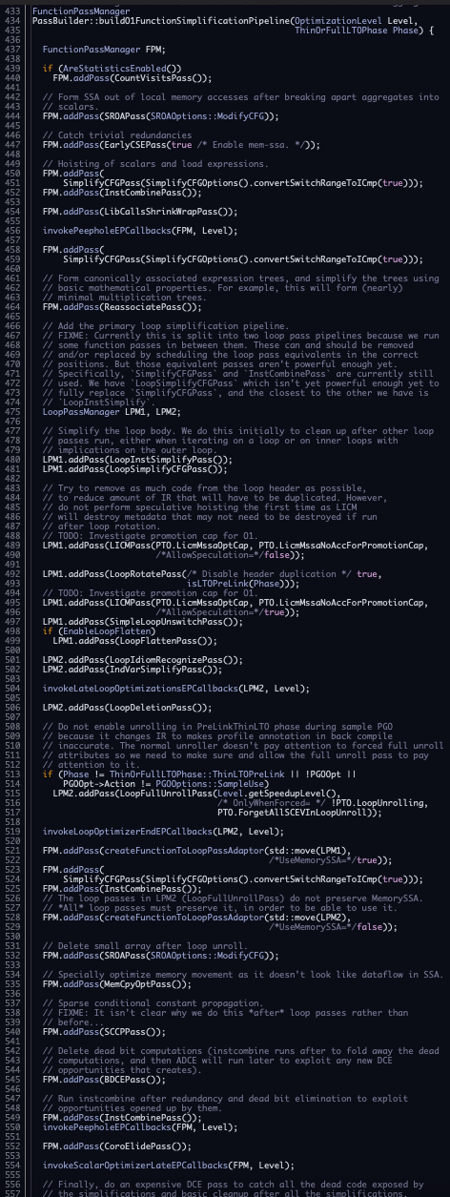
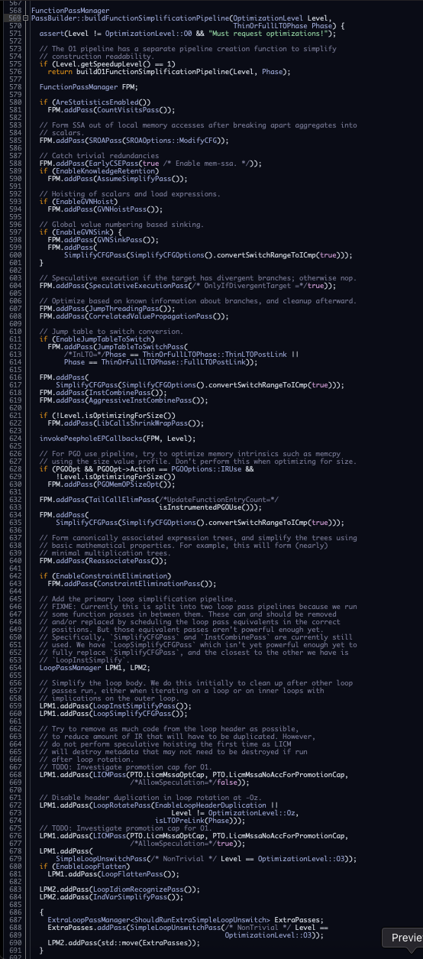

PassBuilderPipelines.cpp

Slide 8
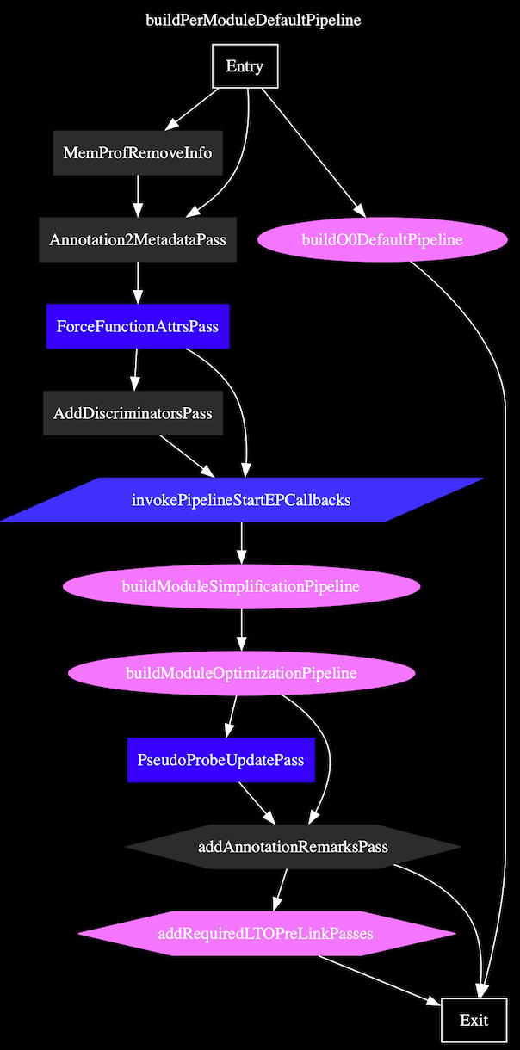
PassBuilderPipelines.cpp

Slide 9
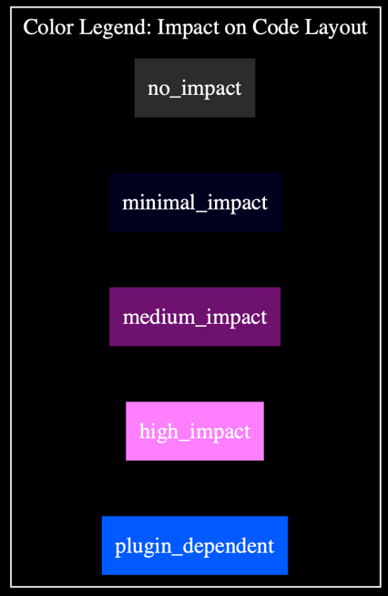
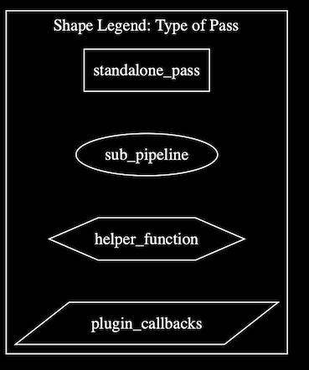


Slide 10
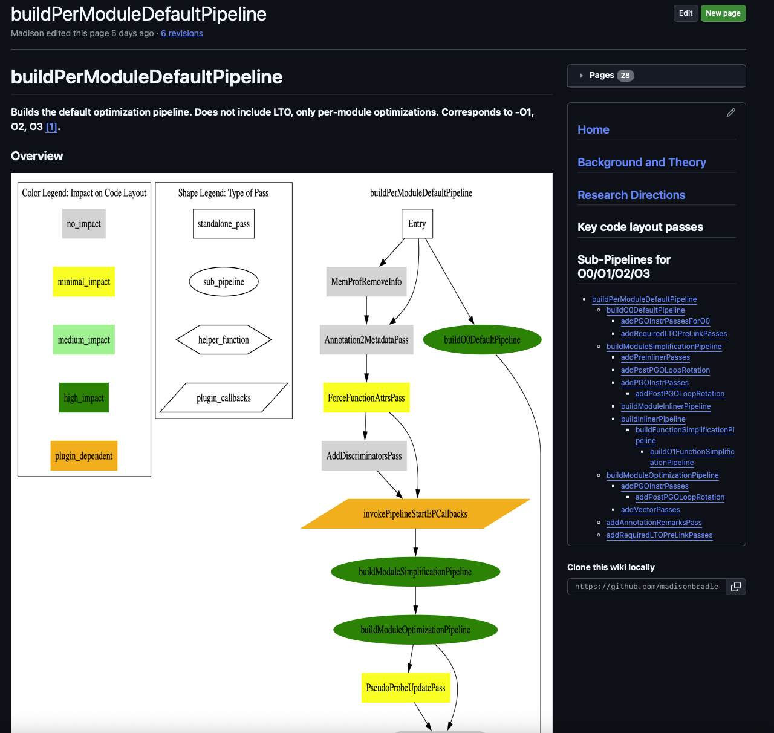
Organization
Collected the information in a GitHub Wiki
Each sub-pipeline in O0/O1/O2/O3 has a page
Diagram and details
Code layout passes with most significant impact on layout have their own page
Linked in the sub-pipeline page whenever they appear
All sub-pipelines accessible via a sidebar on the wiki

Slide 11
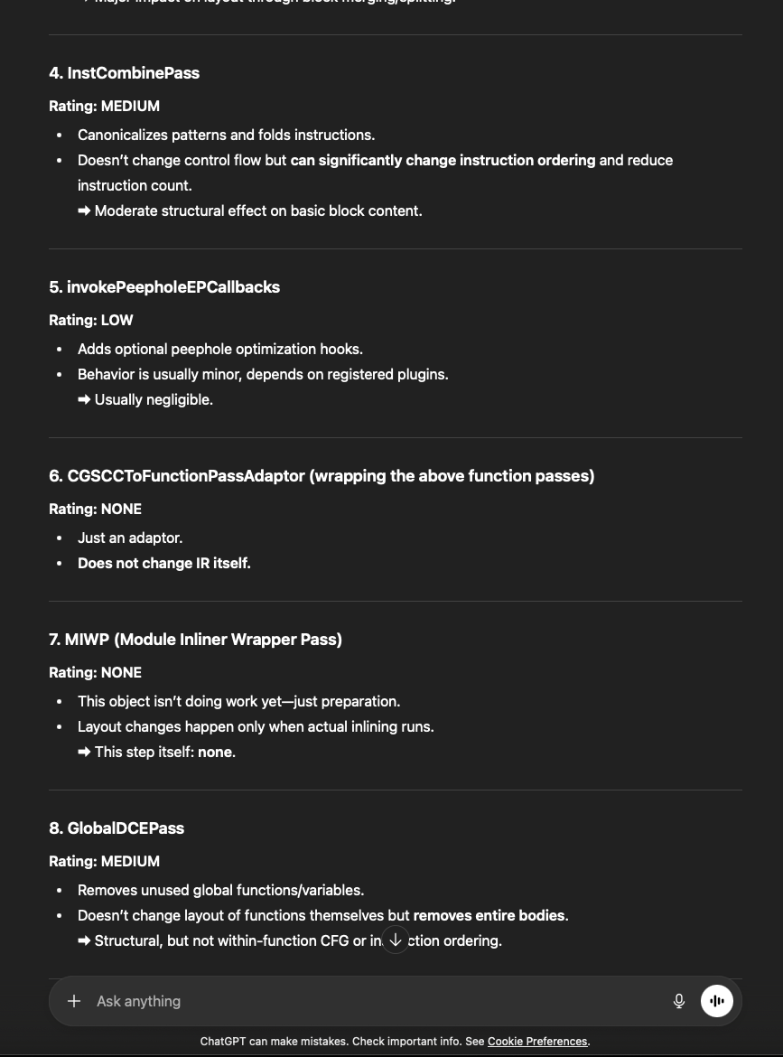
How’d we get the “impact on code layout” values?
Asked ChatGPT
Only used it to tell us where to look; didn’t trust it for details
NONE | LOW | MEDIUM | HIGH
No layout effect. | Indirect or extremely minimal layout effects | Small to moderate CFG changes, such as deleting dead blocks. | Major overhauls of the CFG.

Slide 12
Background
Why are code layout passes important?

Slide 13
Instruction Fetch latency
Code that is executed frequently together should be located together in memory
B1
2000
B2
B4
1000
2000
B4
B5
B3
B6

Slide 14
Instruction Fetch latency
Code that is executed frequently together should be located together in memory
B1
2000
B2
B4
1000
2000
B4
B4
B3
B6

Slide 15
TLB Performance
Frequently executed code should fit together in as few pages as possible to avoid TLB misses.
1
3
TLB
8
11
1
2
3
4
5
6
7
8
9
10
11
12

Slide 16
TLB Performance
Frequently executed code should fit together in as few pages as possible to avoid TLB misses.
1
2
TLB
3
4
1
2
3
4
5
6
7
8
9
10
11
12

Slide 17
Branch Predictor Behaviour
Fall-through edges are better for branch predictors (resistant to BTB misses).
B1
B2
B3
B4

Slide 18
Code Layout

Slide 19
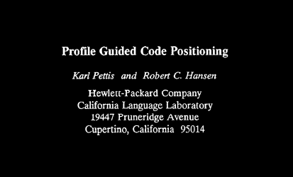
Code Layout Specific Passes/Transformations
Hot-Cold splitting
Function Reordering
Basic Block Reordering

Slide 20
Code Layout Specific Passes/Transformations
Hot-Cold splitting
Function Reordering
Basic Block Reordering
Karl Pettis and Robert C. Hansen. 1990. Profile guided 161
code positioning. In Programming Language Design 162
and Implementation (ACM).

Slide 21
Hot-Cold-Splitting
B1
500
1000
B2
B3
5000
20
2000
5000
B4
B5
B6
1000
1
20
499
2000
B7
B8
B10
B9
20
B11

Slide 22
Hot-Cold-Splitting
B1
500
1000
B2
B3
5000
20
2000
5000
B4
B5
B6
1000
1
20
499
2000
B7
B8
B10
B9
20
B11

Slide 23
Hot-Cold-Splitting
B1
500
1000
B2
B3
5000
2000
5000
B4
B5
B6
1000
20
499
2000
B7
B10
B9
20
B8
B11

Slide 24
Hot-Cold-Splitting in LLVM
H-C splitting passes in both the IR and CodeGen pipelines

Slide 25
Code Layout Specific Passes/Transformations
Hot-Cold splitting
Basic Block Reordering
Function Reordering

Slide 26
Basic Block Reordering
Once the cold blocks are split from the hot blocks, the hot blocks can be reordered
Greedily build chains of blocks that should be placed sequentially
Heuristic:
The most frequently executed path should consist maximally of fallthrough edges

Slide 27
Basic Block Reordering
B1
500
1000
B2
B3
5000
2000
5000
B4
B5
1000
499
2000
B7
B9

Slide 28
Basic Block Reordering
B1
500
1000
B2
B3
5000
2000
5000
B4
B5
1000
499
2000
B7
B9

Slide 29
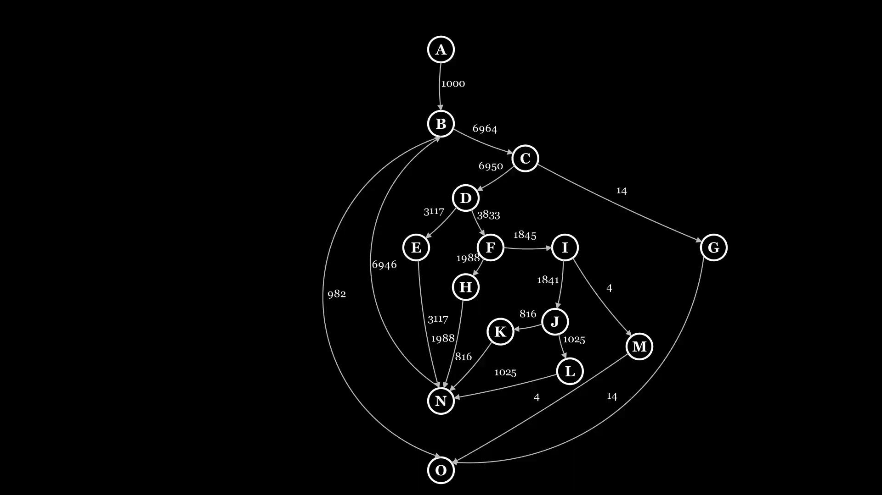

Slide 30
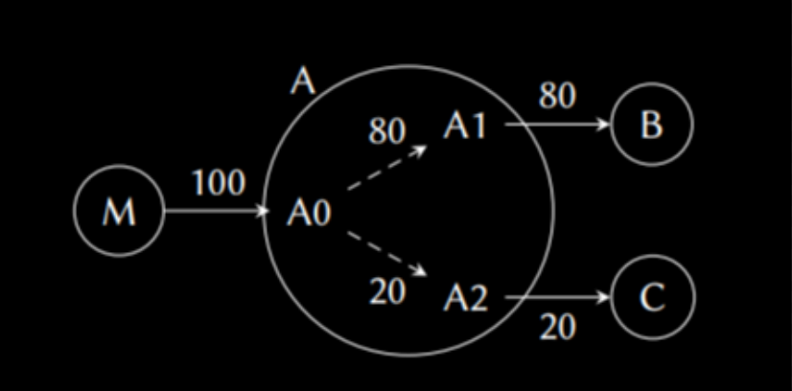
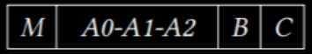
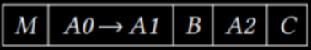
Improvements to Basic Block Reordering
Codestitcher - 2019
Allows functions to be split into an arbitrary number of basic-block chains, which can then be freely interleaved across the whole program
Original PH:
Improved Ordering:
R. Lavaee, J. Criswell, and C. Ding, “Codestitcher: Inter-Procedural Basic Block Layout Optimization,” arXiv preprint arXiv:1810.00905, 2018. [Online]. Available: http://arxiv.org/abs/1810.00905

Slide 31
Improvements to Basic Block Reordering
Improved Basic Block Reordering - 2020
Prior methods assume that maximizing fall-throughs always correlates with optimal cache and front-end performance
Used ML to discover a better cost function: Ext-TSP

Slide 32
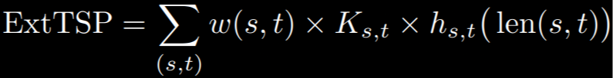
Ext-TSP
Machine Learned block positioning cost function includes these components:
Fall-through edges (which are still the most valuable feature)
Jump length (shorter jumps are better, because short jump targets may lie within the same cache line)
Jump direction
Branch type (conditional or unconditional)
A. Newell and S. Pupyrev, “Improved Basic Block Reordering,” CoRR, 2018, [Online]. Available: http://arxiv.org/abs/1809.04676

Slide 33
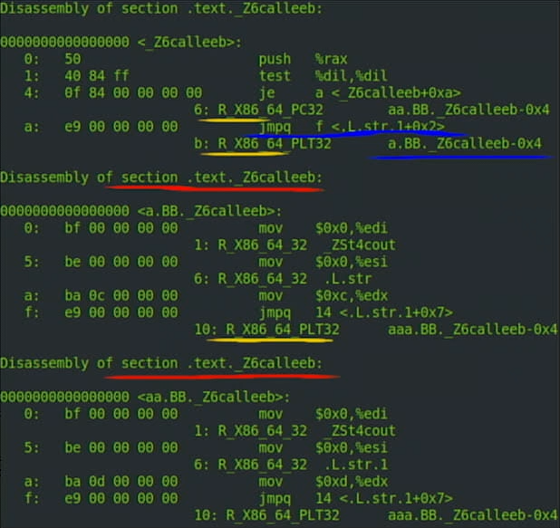
Improvements to Basic Block Reordering
Propeller - 2023
Link-time positioning optimization
Introduced basic block sections
Linker can reorder/sort basic block sections similar to function sections
Uses Ext-TSP to optimize ordering of blocks
https://www.youtube.com/watch?v=DySuXFGmB40

Slide 34
Block Reordering in LLVM
Implemented in MachineBlockPlacement
“The biggest problem with doing block layout at the IR level is that you don't have the final CFG…”- Cameron Zwarich (LLVM dev)

Slide 35
MachineBlockPlacement
Contains 3 separate and independent heuristics:
Classic basic block chaining
Tail duplication
Ext-TSP block chaining (post-processing)

Slide 36
MachineBlockPlacement
First, uses a top-down approach derived from the original PH algorithm, with a few important details:
Starts building chains from innermost loop header first, moving outwards.
When selecting successors:
Considers the profitability of tail duplication during block placement

Slide 37
Code Layout Specific Passes/Transformations
Hot-Cold splitting
Basic Block Reordering
Function Reordering

Slide 38
Function Reordering
Greedily build groups of frequent caller-callee functions that should be placed together
Done very late in the compilation process (link time, even post link time)

Slide 39


Slide 40
Passes/Transformations with Byproducts that alter Code Layout
Function Inlining
Tail duplication and tail merging
And many more…

Slide 41
Passes/Transformations with Byproducts that alter Code Layout
Function Inlining
Tail duplication and tail merging
And many more…

Slide 42
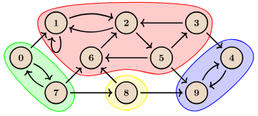
Function Inlining in LLVM
There are multiple inliner passes in LLVM, they all occur very early in the compilation process (Early IR)
Module Inliner:
A global view of inlining: creates a priority queue of functions to inline first.
CGSCC Inliner:
Iterates through SCC parts of the call graph

Slide 43
Function Inlining in LLVM
Partial inliner
Splits cold paths from hot paths before inlining the hot paths

Slide 44
Passes/Transformations with Byproducts that alter Code Layout
Function Inlining
Tail duplication and tail merging
And many more…

Slide 45
Tail duplication and tail merging
B1
B1
B2
B4
B2
B4
B3
B5
B3
B5
B6
B6
B6

Slide 46
Thoughts and Ideas

Slide 47
Inlining Adding Cold Code
Inlining can introduce cold code into a function’s hot region.
Could do Hot-Cold splitting before inlining
Inliner could choose full OR partial inlining
Inlining passes could consider hot regions/paths
Not just hot call sites.
This could also reduce instances where:
Hot + Cold code gets inlined into multiple functions
Inlined code gets simplified + transformed
Hot-Cold splitter pass removes similar cold code into separate regions
Increasing total code size

Slide 48
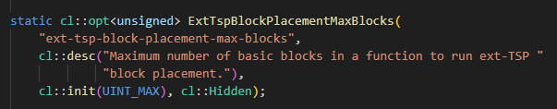
Inlining and block placement
There is a block size threshold for running ExtTSP In MachineBlockPlacement
Code-size expanding transformations could cause ExtTSP to not be used
Sacrificing layout optimizations

Slide 49
ExtTSP default algorithm in MachineBlockPlacement
ExtTSP only used as a post-processing step
Can it be integrated into the main algorithm?
Can build a more optimal layout
Would require tail duplication to be included in the ExtTSP algorithm code

Slide 50
Layout aware Cost Functions
For transformations that could increase hot path code size, cost functions could contain layout aware penalties
Eg. inlining, loop unrolling, duplications
Could block/function analyses be built early to use as context for later pass cost-functions?
Would likely need to be recomputeable and fast as CFG changes a lot.
The reason for not doing block placement in the IR level is because the CFG changes a lot, but maybe there are benefits to knowing good block ordering early on?
Ex. which specific paths are hot and should be fallthroughs

Slide 51
Function Reordering Cache Conflicts
LLVM’s function reordering algorithm (CDSort) does not actively attempt to reduce cache conflict misses.
Unlike previous function reordering algorithms in the literature, yet I-cache has not expanded significantly since then.
Would it be useful to reintroduce this idea?

Slide 52
MachineBlockPlacement Improvements
Is there a more modular or iterative way to handle passes that benefit from being done inline?
Ex. Block placement and tail duplication are currently done inline in MBP because they are interdependent
Instead, separating Tail Duplication from MBP and iterating with a shared layout objective improve anything?

Slide 53
Partial Inlining and Hot-Cold Splitting
Partial inlining must do a CFG traversal to find cold regions of code to detach before inlining the hot code. This is very similar to the goal of hot-cold splitting.
Their graph traversal methods and objectives are different
Cold source edge + maximize inline profits
Cold destination + locality profits
Why not combine the grouping of cold blocks into a singular IR analysis?

Slide 54
There’s a lot more!
Due to brevity, we weren’t able to cover all passes affecting layout.
There’s a lot, and many of them could fill a lecture on their own!
When this course is finished, we invite you to check our GitHub wiki
Will have pages detailing the passes, an overview of pipelines, background and history on LLVM’s layout optimizations, and more ideas.

Slide 55
That’s a wrap

Slide 56
Thoughts and Ideas
Could there be a separate pipeline dedicated to layout optimizations that can be used for code that is heavily bottlenecked by I-TLB or I-Cache latency?
The pass would prioritize code layout objectives
Passes could be reordered in ways that may be suboptimal for programs that are not fetch bottlenecked, but good for layout.
Frequent block/procedure chains could be built early and provided as context for later pass cost-functions

Slide 57
Cost Function Tuning - LTO
Could cost functions be tuned automatically depending on the expected code size of final binary? For example, a very large application could be flagged, and link-time cost function parameters could be tuned to more heavily

Slide 58
Inlining Heuristics
+ Gains from further optimizations that can be done as a result of inlining (ex. Constant propagation)
- Size of function to be inlined
+/- Hotness/Coldness of the call to inline (Better to inline hot)

Slide 59
Function Inlining in LLVM
CGSCC Inliner:
Iterates through the call graph with a bottom-up approach to inlining. Updates the CG edges after inlining (where applicable) until reaching a fixed point.
inlining and simplification are interleaved: inline/simplify callees first, then callers.
https://cp-algorithms.com/graph/strongly-connected-components.html

Slide 60
Why Function Inlining Affects Code Layout
Function size expansion
Cold code can be introduced into a hot function, lowering I-cache performance
Has trickle-down effects on layout block placement and hot-cold splitting results

Slide 61
function(x):
if x <= 0:
...
log_error(...)
if x == NULL:
...
log_error(...)
MAIN CODE SECTION
...
return

Slide 62
function(x):
if x <= 0:
...
log_error(...)
if x == NULL:
...
log_error(...)
MAIN CODE SECTION
...
return

Slide 63
Function Inlining
function(x, Y):
if x >= 0:
function1()
if x == Y:
function2()
...
return
function1():
FUNCTION 1 CODE
return
function2():
FUNCTION 2 CODE
return

Slide 64
Function Inlining
function(x, Y):
if x >= 0:
FUNCTION 1 CODE
if x == Y:
FUNCTION 2 CODE
...
return

Slide 65
function(x):
if x <= 0:
coldcode1()
if x == NULL:
coldcode2()
MAIN CODE SECTION
...
return
coldcode1():
...
log_error(...)
coldcode2():
...
log_error(...)

Slide 66
Why Tail Duplication/Merging Affects Code Layout

Slide 67
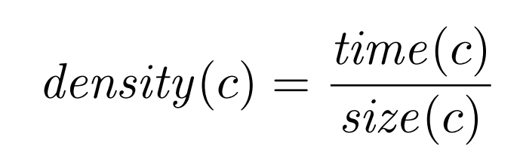
Improvements to Function Reordering
Density metric “[Tries] to pack most of the execution time in as few code pages as possible, in order to further improve locality” (Guilherme Ottoni and Bertrand Maher)
G. Ottoni and B. Maher, "Optimizing function placement for large-scale data-center applications," 2017 IEEE/ACM International Symposium on Code Generation and Optimization (CGO), Austin, TX, USA, 2017, pp. 233-244, doi: 10.1109/CGO.2017.7863743.

Slide 68
Improvements to Function Reordering
CDSort - 2023
Improvement over HFSort

Slide 69
Function Reordering in LLVM

Slide 70
Improvements to Function Reordering
Cache Line Colouring - 1997
Reduce cache conflicts
Temporal-ordering placement - 1997
Procedures which execute frequently in close alternation are the most likely to interfere in the instruction cache and therefore should be placed to minimize temporal overlap.

Slide 71
Thoughts and Ideas
Is there a better way to manage passes that should be done inline - for example tail duplication and tail merging are both done in MachineBlockPlacement which seems rather complex.
Could there be a separate pipeline dedicated to layout optimizations to be used on code that is bottlenecked by iTLB or iCache latency?
Could function inlining be done very aggressively and then hot-cold splitting does the cleanup?

Slide 72
Thoughts and Ideas
Update inliner heuristics to specifically avoid inlining functions with a lot of cold code into the caller? Could modify the InlineAdvisor
Inline->Split->Merge functions
Is there a way to auto-tune cost parameters (for passes like hot-hot-splitting) depending on the input code size? Cost models for code layout may not be equally beneficial across all applications.
Could hot-cold splitting be done before inlining?
Could hot-cold splitting and inlining work together better?
Is there a better way to manage passes that should be done inline - for example tail duplication and tail merging are both done in MachineBlockPlacement which seems rather complex.
Could function inlining be done very aggressively and then hot-cold splitting does the cleanup?

Slide 73
Thoughts and Ideas
Is this enough of an improvement to no longer worry about conflict misses?
Could a layout-specific pipeline alter the heuristics for transformations that would increase code size (like inlining, unrolling, function cloning)_ to be more restrictive to hot code, and less restrictive to cold code, since the overall objective is shifted?

Slide 74
Ext-TSP
Machine Learned block positioning cost function includes these components:
Fall-through edges (which are still the most valuable feature)
Jump length (shorter jumps are better, because short jump targets may lie within the same cache line)
Jump direction
Branch type (conditional or unconditional)
Weight coefficient for the importance of the branch ([0,1])
A. Newell and S. Pupyrev, “Improved Basic Block Reordering,” CoRR, 2018, [Online]. Available: http://arxiv.org/abs/1809.04676

Slide 75
Ext-TSP
Machine Learned block positioning cost function includes these components:
Fall-through edges (which are still the most valuable feature)
Jump length (shorter jumps are better, because short jump targets may lie within the same cache line)
Jump direction
Branch type (conditional or unconditional)
Function that accounts for jump length
A. Newell and S. Pupyrev, “Improved Basic Block Reordering,” CoRR, 2018, [Online]. Available: http://arxiv.org/abs/1809.04676

Slide 76
Ext-TSP Model Results
Fallthrough edges are still worth the most
Branch distance
Branch type
Backwards edges
Forwards edges
A. Newell and S. Pupyrev, “Improved Basic Block Reordering,” CoRR, 2018, [Online]. Available: http://arxiv.org/abs/1809.04676

Slide 77

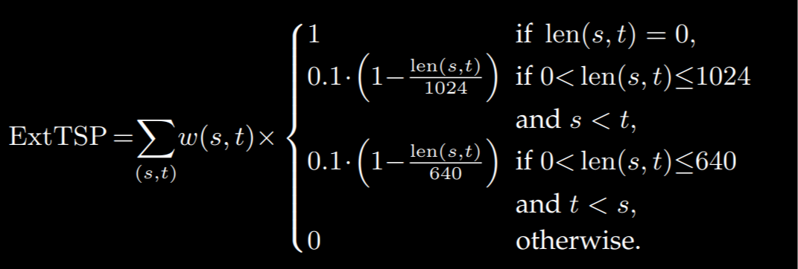
Learned via a black-box solver based on Bayesian optimization
A. Newell and S. Pupyrev, “Improved Basic Block Reordering,” CoRR, 2018, [Online]. Available: http://arxiv.org/abs/1809.04676

Slide 78
Thoughts and Ideas
Hot-Cold splitting can be included within LLVM’s iterative call-graph inliner:
For each SCC in the graph, do this:
inline->Simplify->Hot-cold split

Slide 79
Thoughts and Ideas
Why is inlining, partial inlining, and hot-cold splitting all done separately and unaware of each other?
Why only tail dup inline with block placement?

Slide 80
MachineBlockPlacement
Classic block chaining
Follows the original PH top-down algorithm fairly closely
Greedy
Starts with inner loop blocks
Heuristic used:

Slide 81
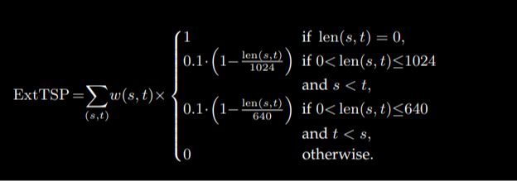
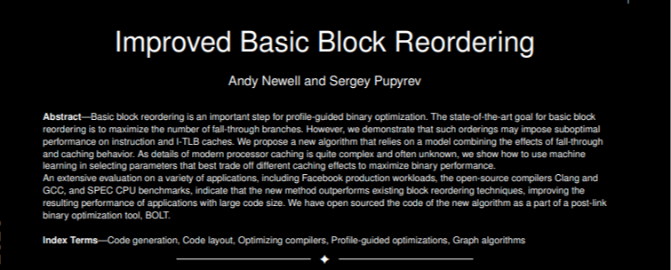
Machine Block Placement
Ext-TSP block chaining
Does not run by default in LLVM’s O0-O3 pipelines
Heuristic used:

Slide 82
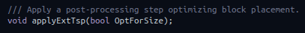
Potential Further Directions (Machine Block Placement)
extTSP is currently only done as a postprocessing step.
Are there better ways to handle circular pass change dependencies or at least integrate tail dup/merge into the extTSP algorithm instead of stitching together essentially 3 separate heuristics?
Would it be good for block placement algorithms to be aware of page boundaries?
Improved Heuristics for Tail duplication
The current ones may be conservative

Slide 83
Why does tail duplication happen inside Machine Block placement, as well as on its own?

Slide 84
Machine Function Splitter
Uses basic block section infrastructure from Propeller, instead of call instructions like the IR level splitter pass.

Slide 85
Talk about how target specific layout passes are
They don’t really seem to be target specific

Slide 86
Potential Directions unassigned
More communication between Function Inlining and other layout algorithms
Could a more unified heuristic be helpful here?
Include profiling information “micro-benchmarks” that targets cache/prefetcher behavior to collect data to give to a more cache-aware placement algorithm.

Slide 87
Is there an option to choose between inlining and partially inlining globally? Why not just aggressively inline and then let hot cold splitter remove the cold stuff?
Apparently they both run, why is this good?

Slide 88
Function inlining may increase the size of code for it to now be infeasible to run extTSP on the combined function- are there other tradeoffs when inlining too early?
Could the cycle dependency of tail dup and block placement be solved in a better way? (like a more modular and iterative solution that can be used for different passes as well),
How was the extTSP heuristic found? Based on which back end? Should this heuristic be made more cache-aware to not accidentally thrash? Where did cache conflict awareness go? Would this be different for riscV
Why are partial inlining and hot cold splitting so separate?

Slide 89
Could extTSP heuristic (or even the default block placement algorithm in MachineBlockPLacement.cpp) be made page aware? Block size is a rough estimate at this stage, but a page should be big enough to account for noise.

Slide 90
Should cache conflicts once again be made important to HFSort? It used to be important to function placement algorithms, but suddenly disappeared even though modern i caches are not much larger than in the late 90s (only about double in size and associativity citing that one paper i read but i forgot which exact one)
Size didnt get much bigger because i cache needs to be very very fast and not slowed by search

